Slide 1
HOME FIX
Home Services Providing Website
Ruhi Asitkumar Joshi - 20075076
Manvi Diwakar - 20075051

Slide 2
OBJECTIVE
We have build a web application, where customers can register and then login to book domestic services such as Electric service, AC services, Plumbing and Carpentry by choosing the required location where they want service and choosing the service provider of their own choice from the list.

Slide 3
MOTIVATION
This website will provide an easy and convenient way to find a trained and reliable professional service provider for domestic services near the required location.
Users will get an option to choose among different service providers based on their skills, reviews and rating.

Slide 4
METHODOLOGY
MySQL Database is used to store data
Django framework (Django 3.2.6) is used for backend
Python 3 is used for coding part of Django

Slide 5
FEATURES
User registration and login
Creating a form in which user can choose service he requires and in which location
Providing user with a list of service providers along with their ratings, reviews, minimum charges and speciality based upon service (Electric service, Plumbing, AC services or Carpenter) and location (Area1, Area2, Area3 or Area4) he/she chose and the availability of service provider (if the number of services assigned to a provider reaches to its max limit on a day then he will not be available on that day)
Providing user the option to choose among the given list of service providers and then book the service
Providing user the list of services he/she has requested and the option to cancel service, give rating and reviews of the service provider
Providing users (registered and anonymous) a contact us form where they can request for contacting the website holder for technical issues or any other queries/complain
Creating a mediator page where he/she can see all the services requested and the status of services and can filter the services requested on different basis, and also can see the details of all service providers
Providing option to mediator to change the status of services, and also reset the assigned number of services of the service providers for the next day, depending upon the pending requests at the end of current day. (The concept is that a particular service provider can provide at max a certain number of services in one day, which is prefixed by in the database)

Slide 6
Source Code
itw2 – name of project
home_fix – name of first app (For users/customers page)
mediator – name of second app (For mediator page, who controls all the services requested by customers)
static (Stores css, javascript and images used in the project/website)
Database
Service_provider model is the main model which stores the details of service providers, there are 4 services: Electric service, AC services, Plumbing and Carpenter, each service provided in 4 areas Area1, Area2, Area3, Area4, and in each area there are 4 service providers for each service. Therefore there are total 64 service providers.
Users model stores the details of user
Service_requested model stores all the services requested by user/customer
Contact_Us model stores the details of contact requests made by users
Reviews model stores the reviews given to service providers by customer

Slide 7
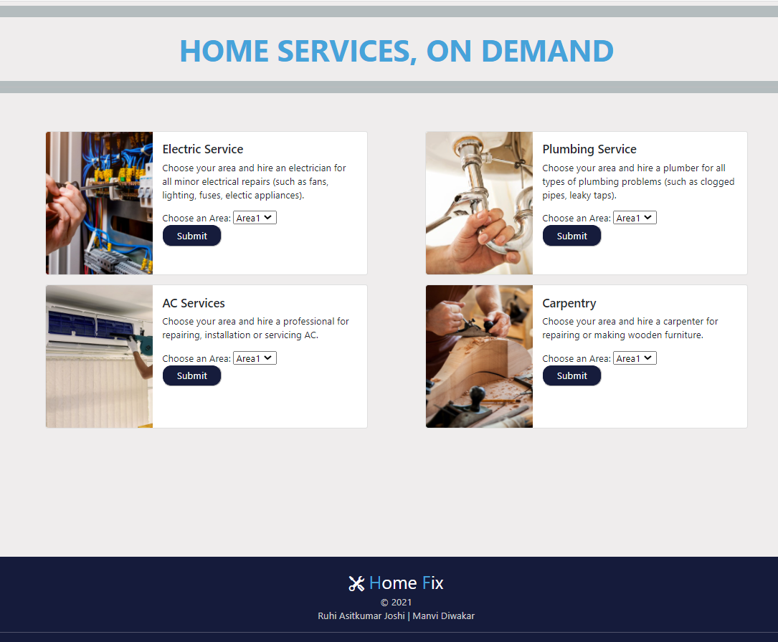
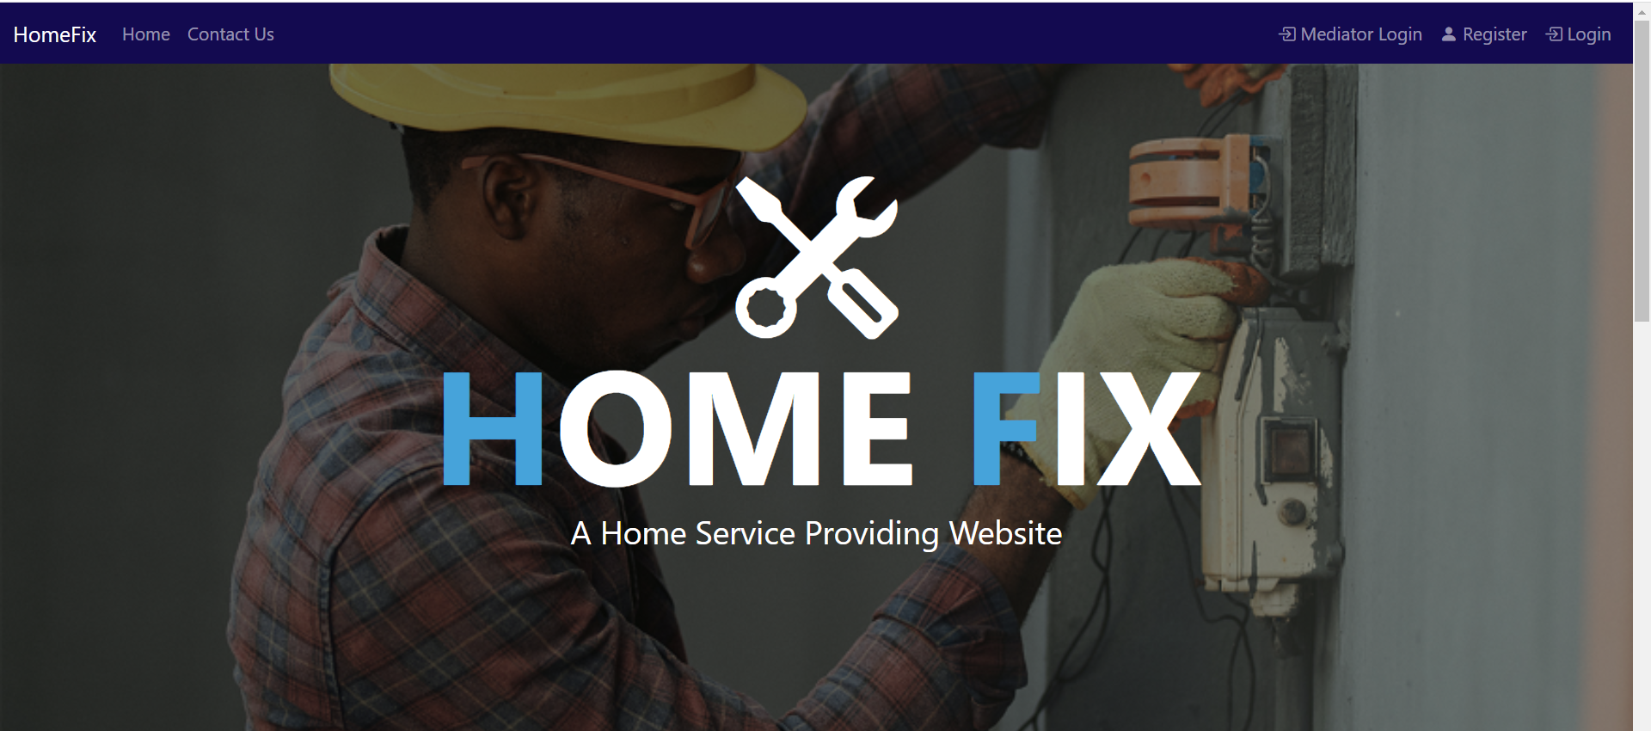
Home Page

Slide 8
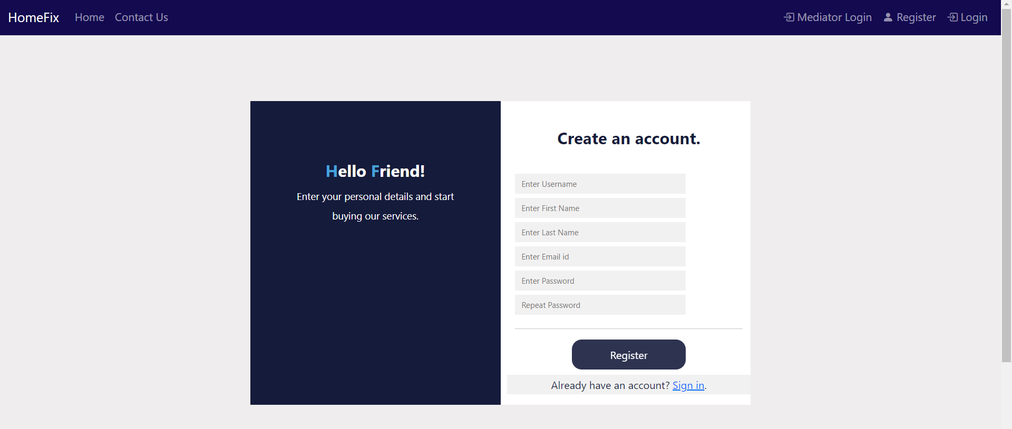
Register Page

Slide 9
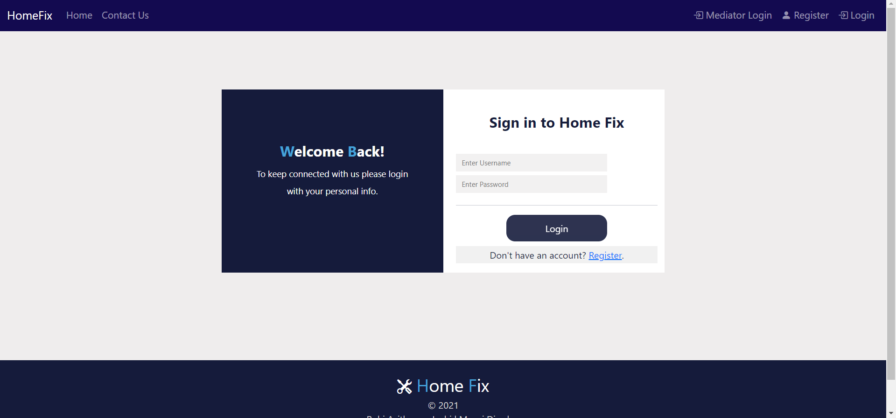
Login Page

Slide 10
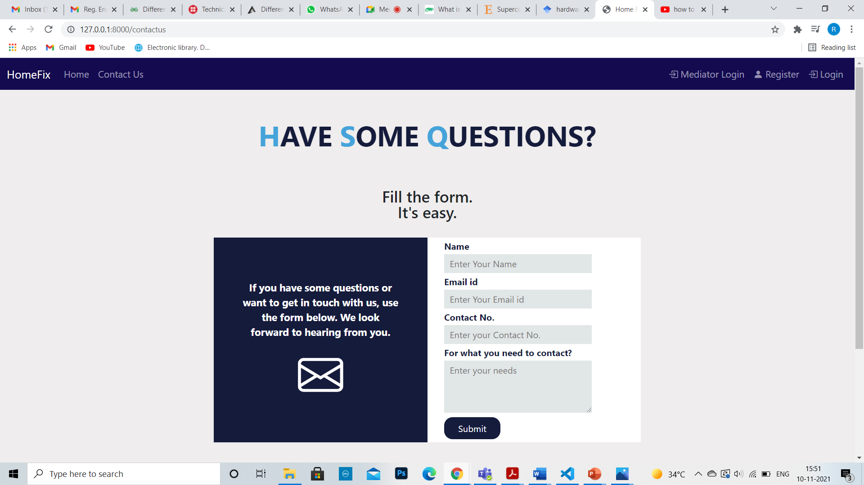
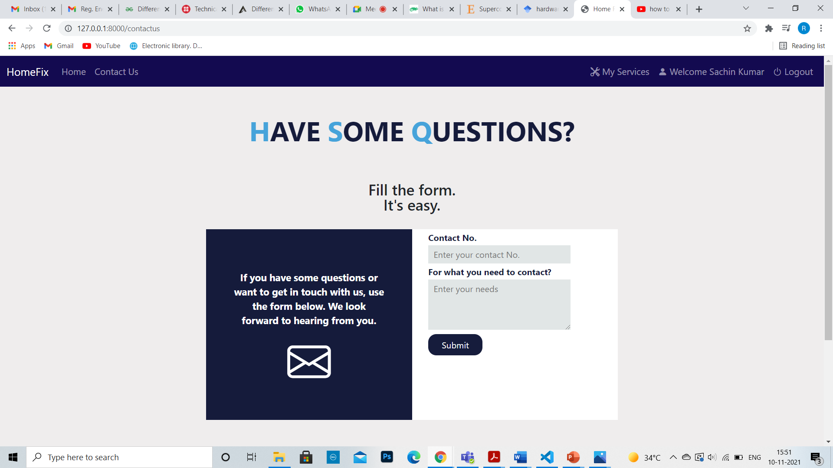
Contact Us Page
For anonymous user
For signed in user

Slide 11
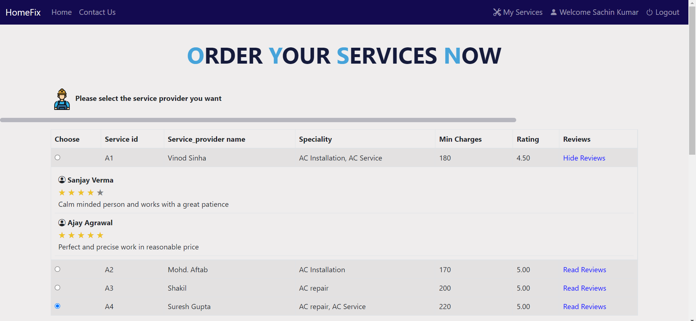
Page for Ordering services
After choosing service and area (AC Services, Area1 in this screenshot)

Slide 12
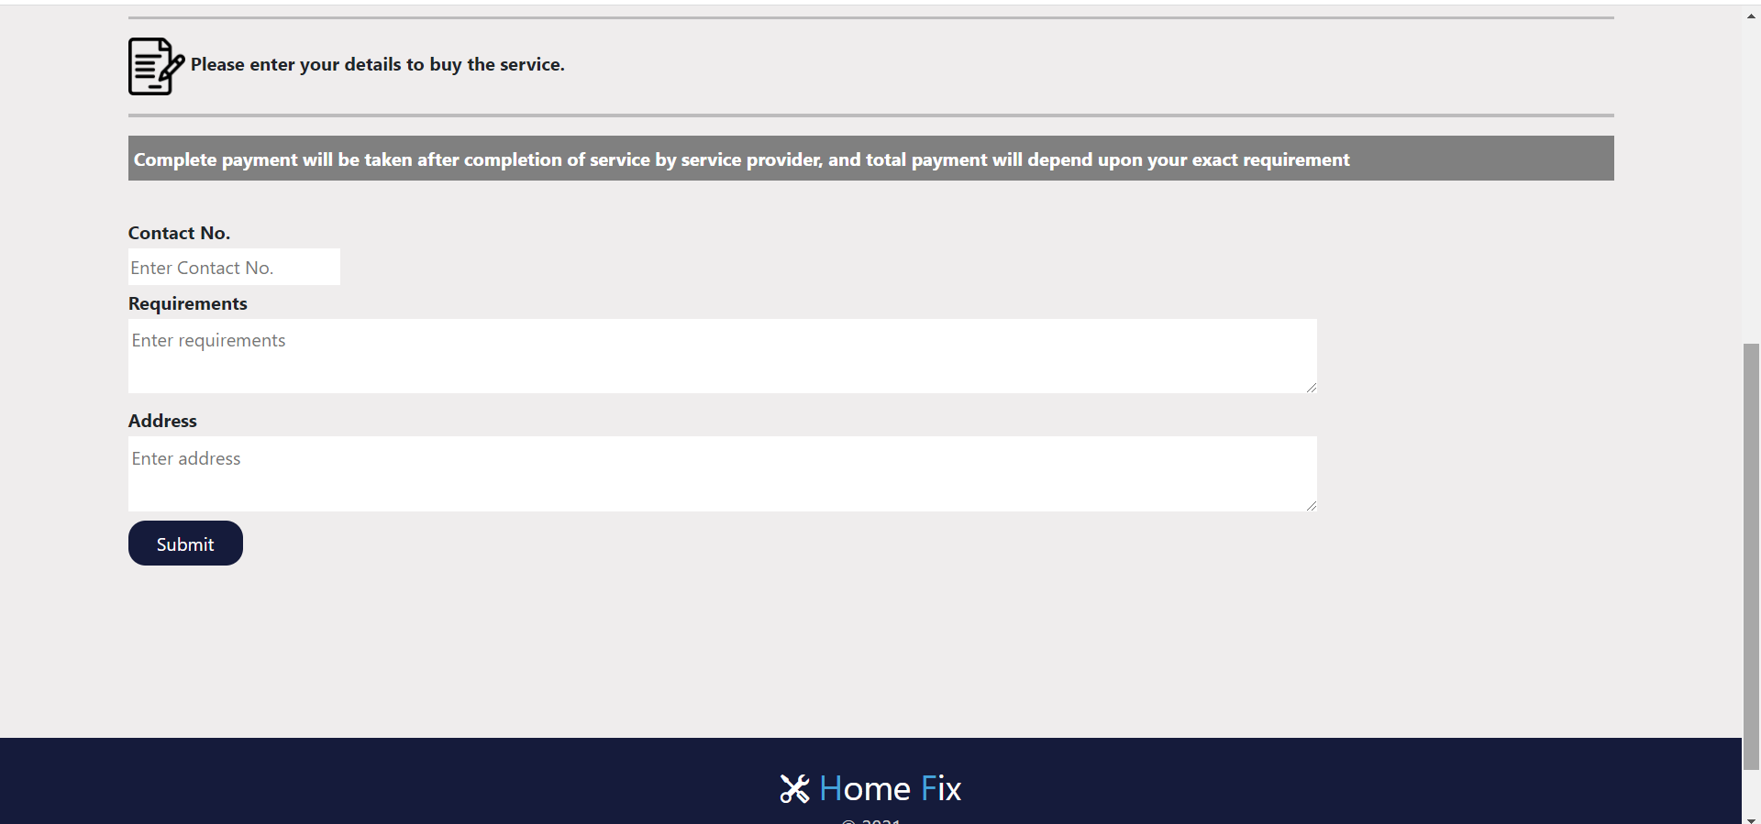
Previous page continued….

Slide 13
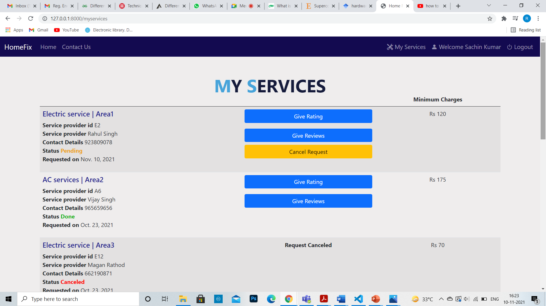
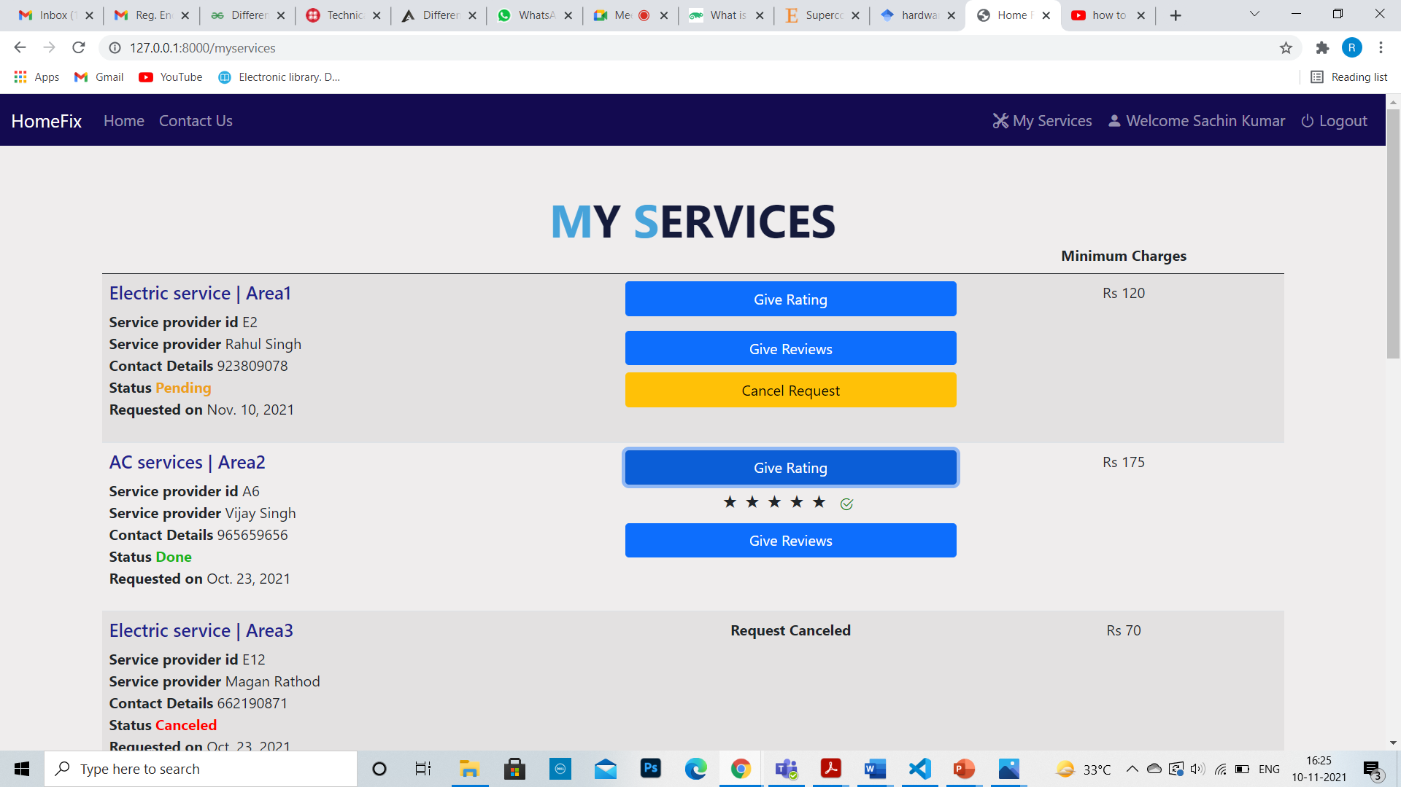
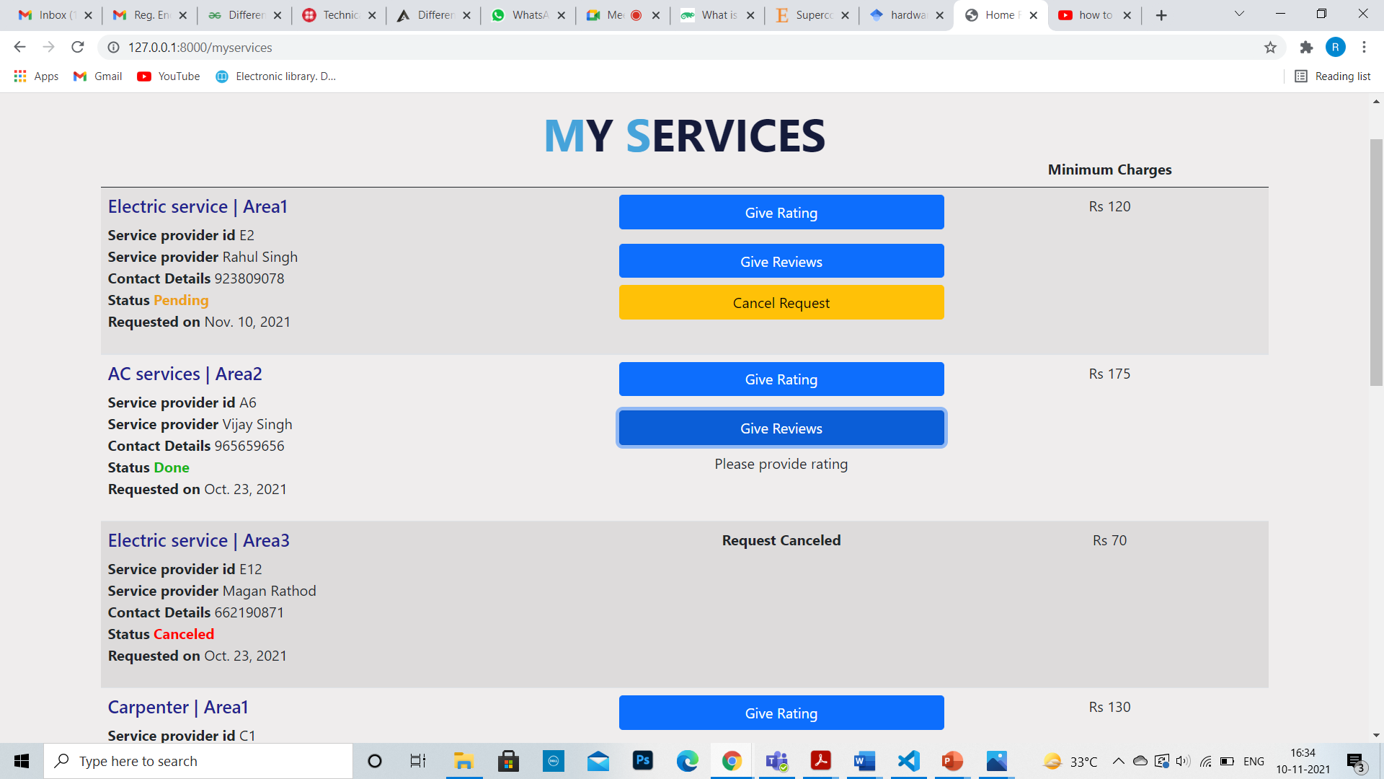
My Services Page
Giving rating
Giving review

Slide 14
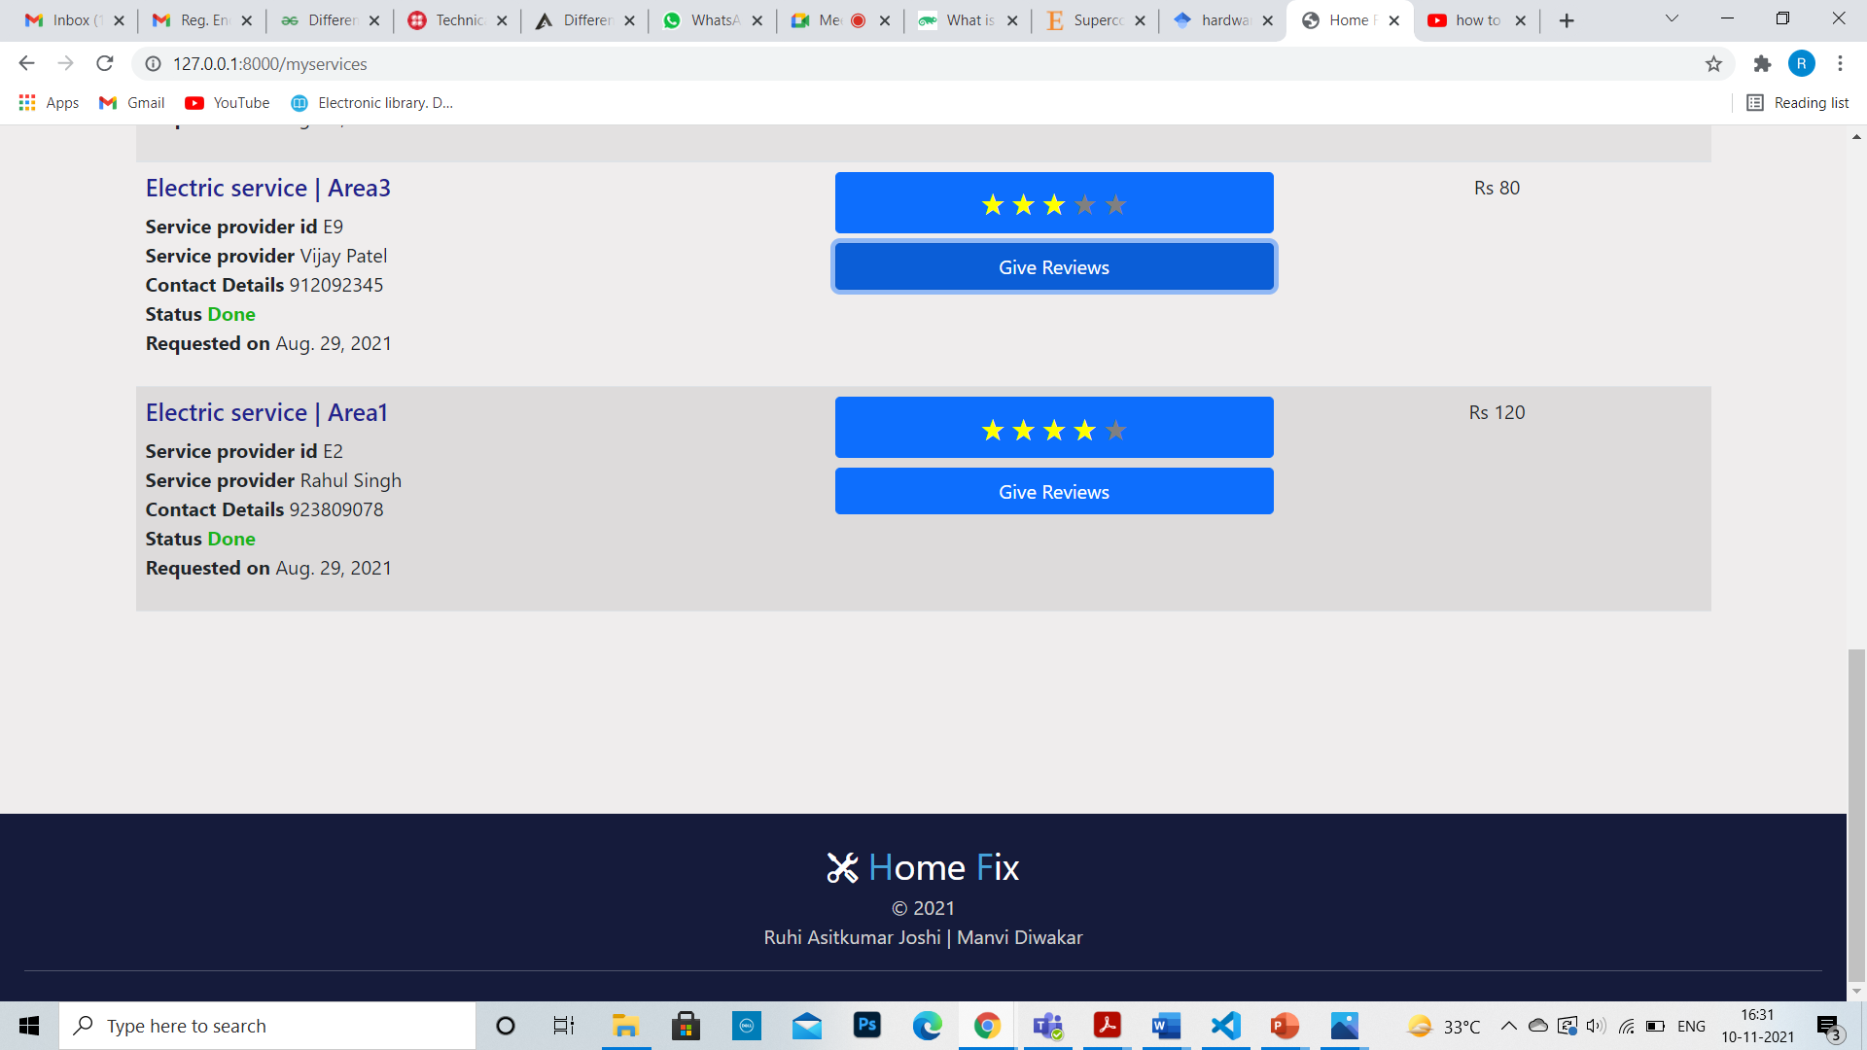
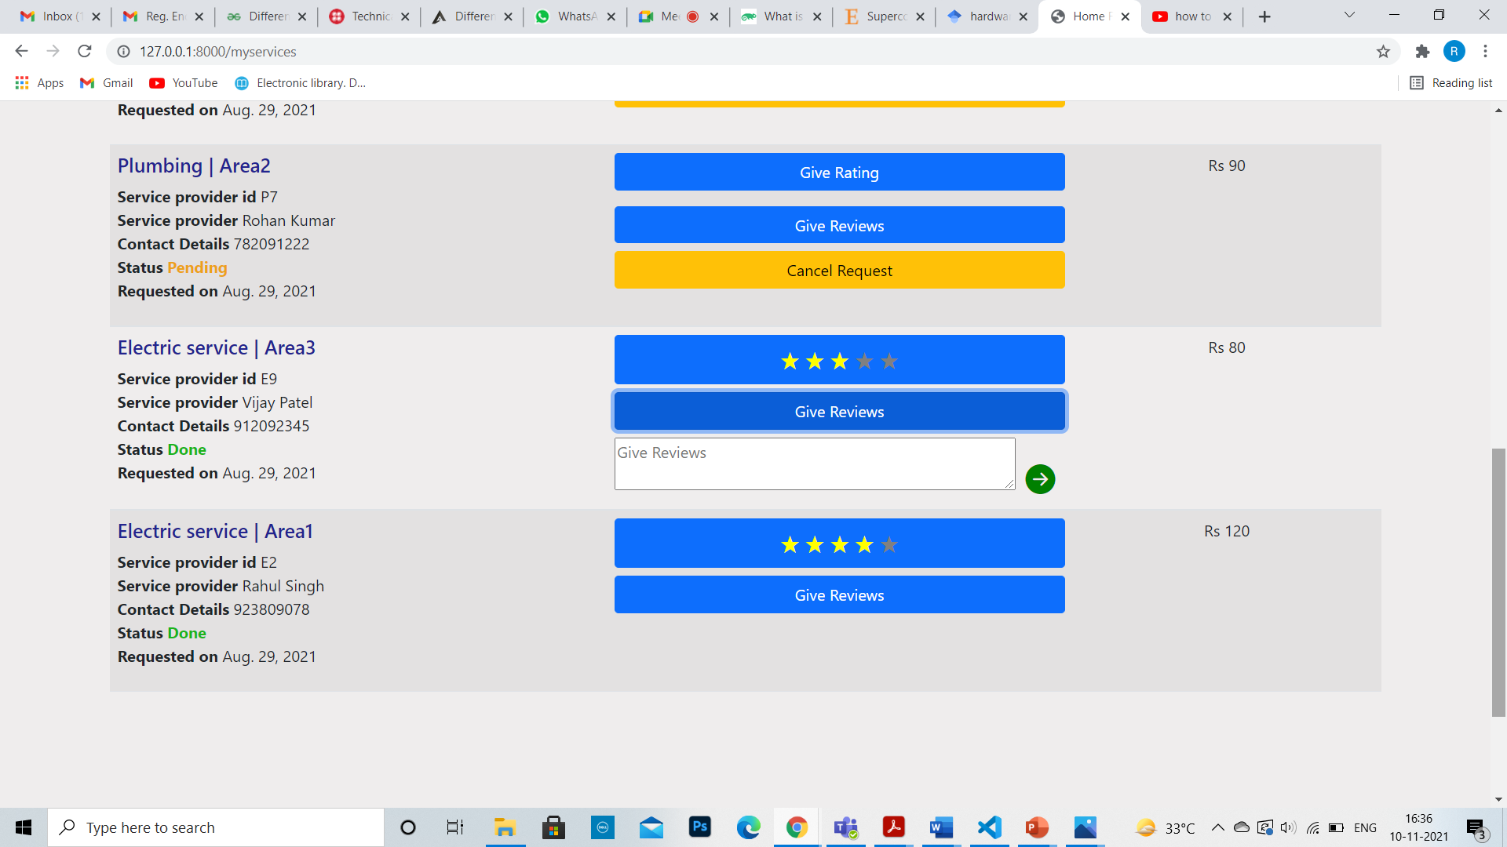
My services page: Continued
Giving reviews

Slide 15
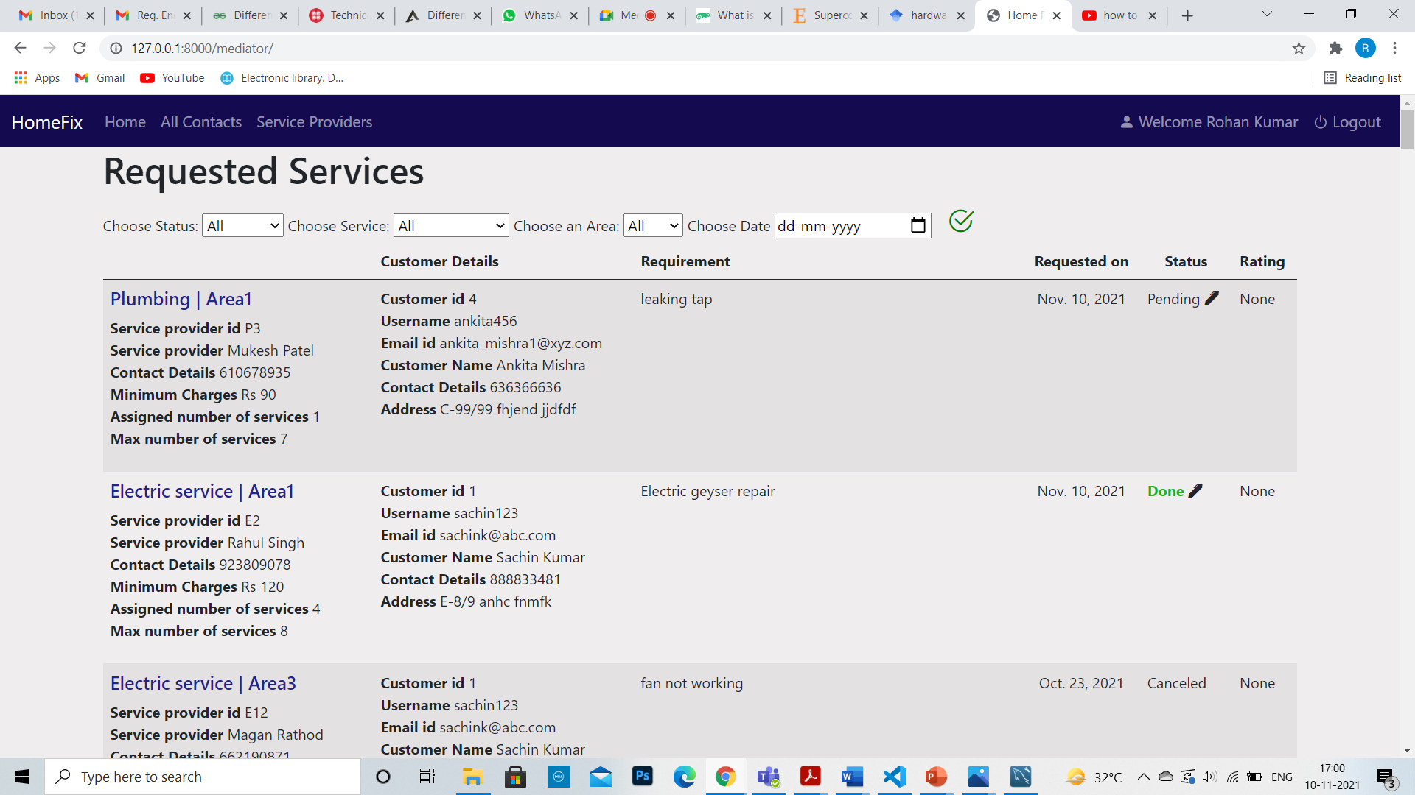
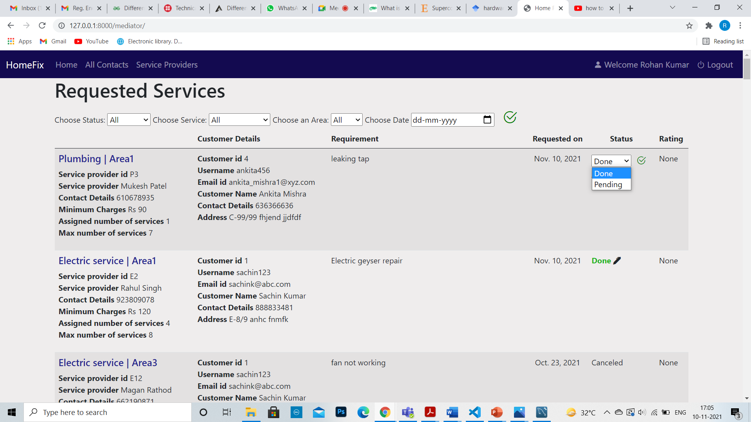
Mediator Page (All Services requested)
Changing Status

Slide 16
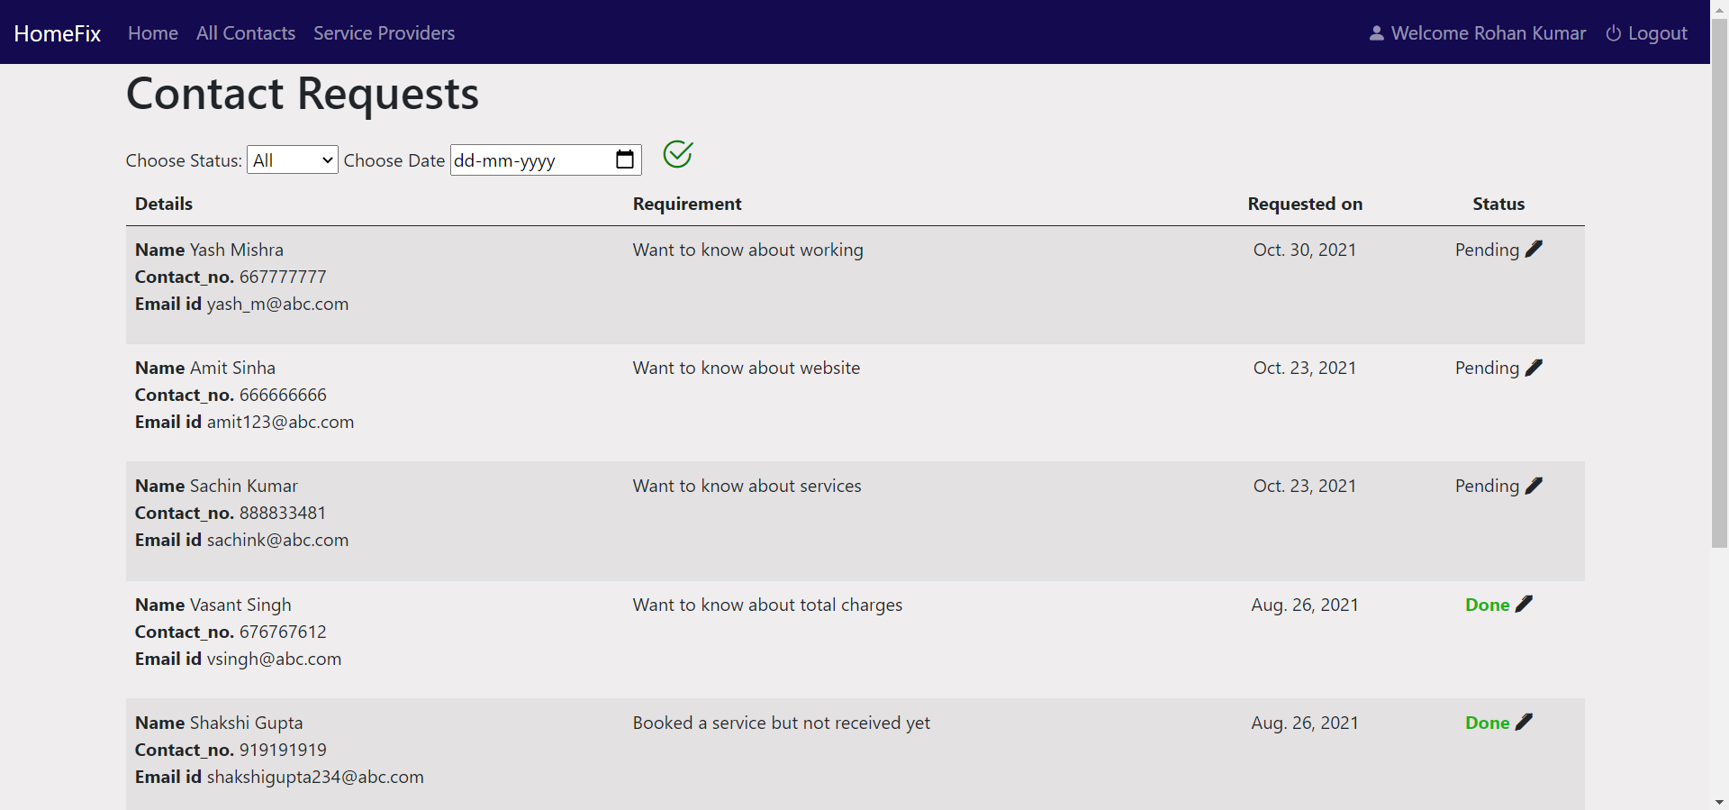
Mediator Page (All Contacts requested)

Slide 17
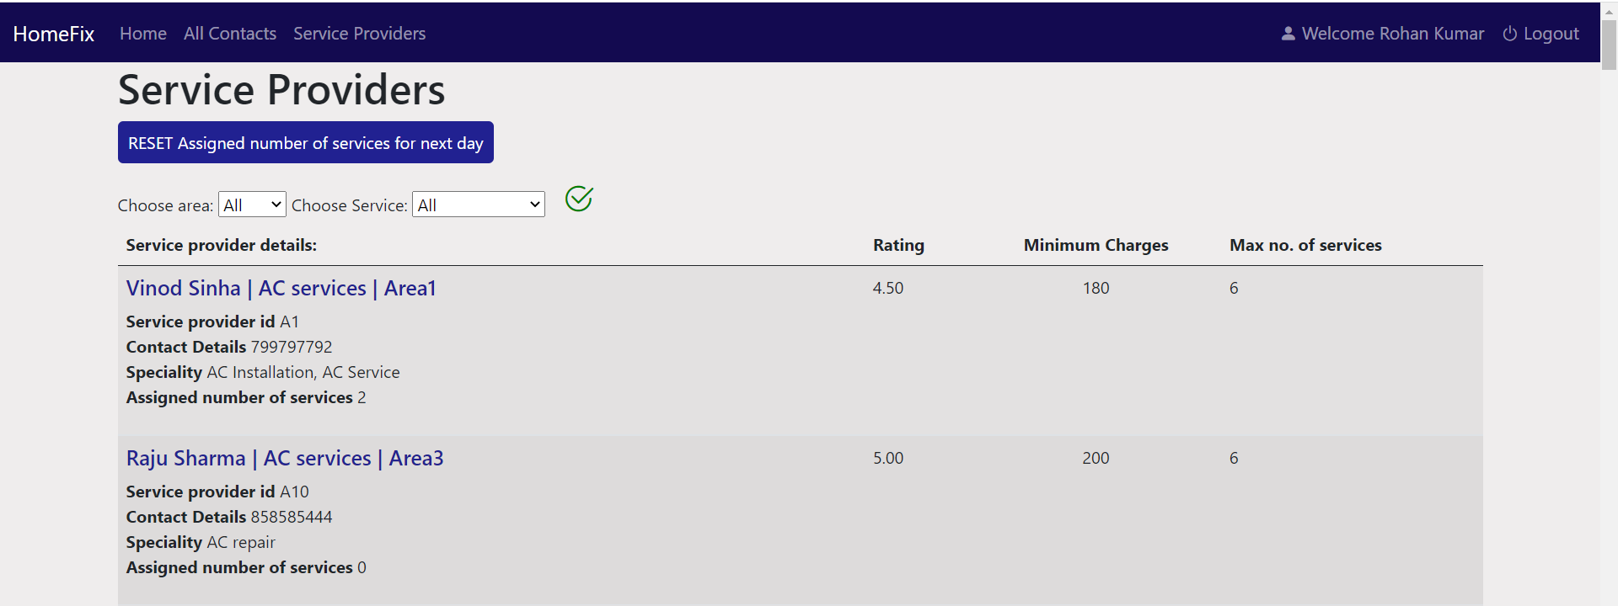
Mediator Page (All Service providers)

Slide 18
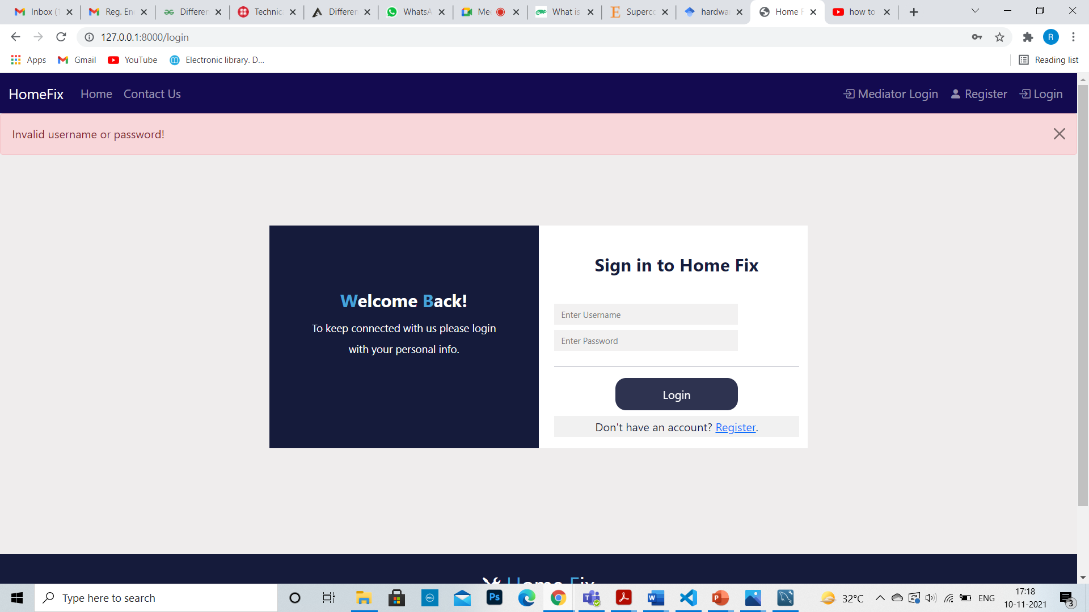
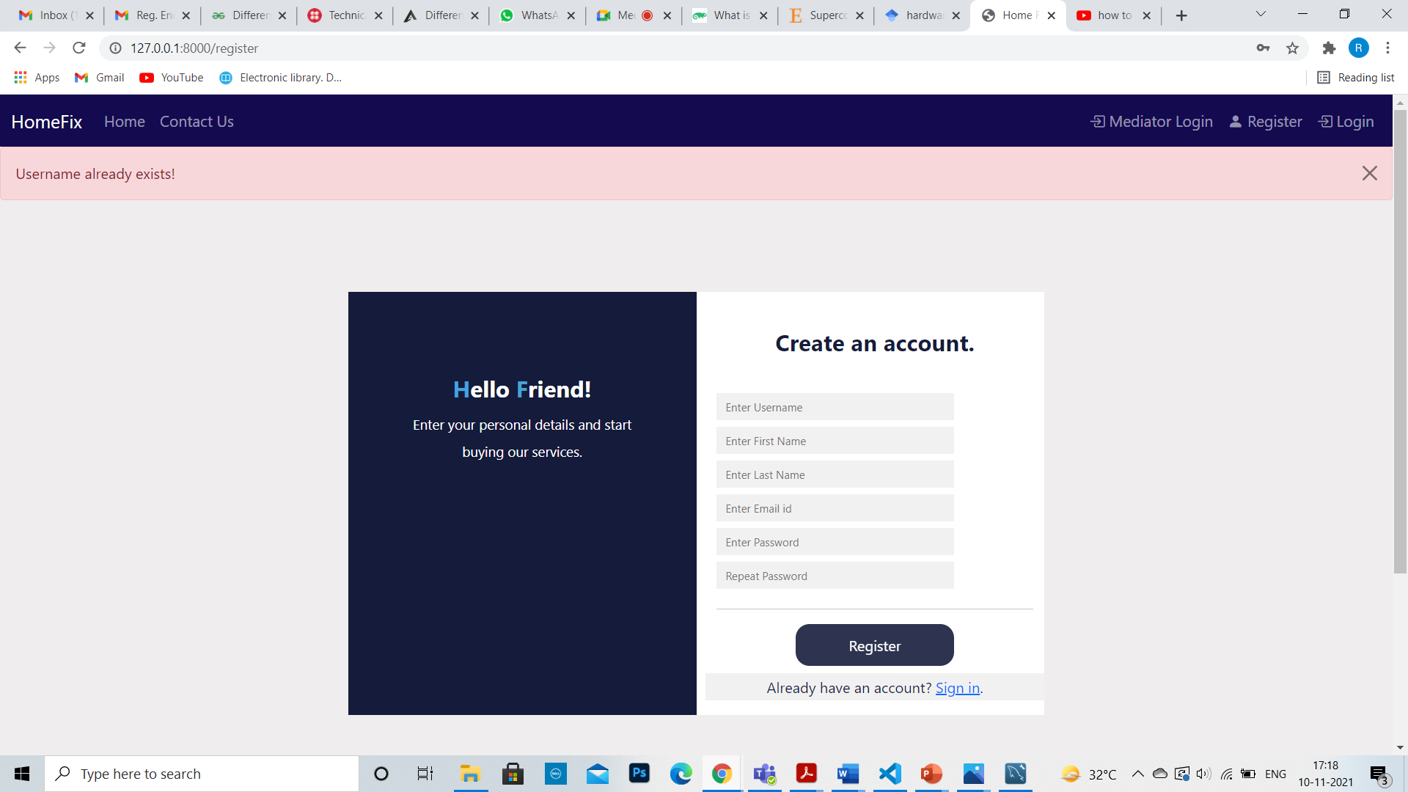
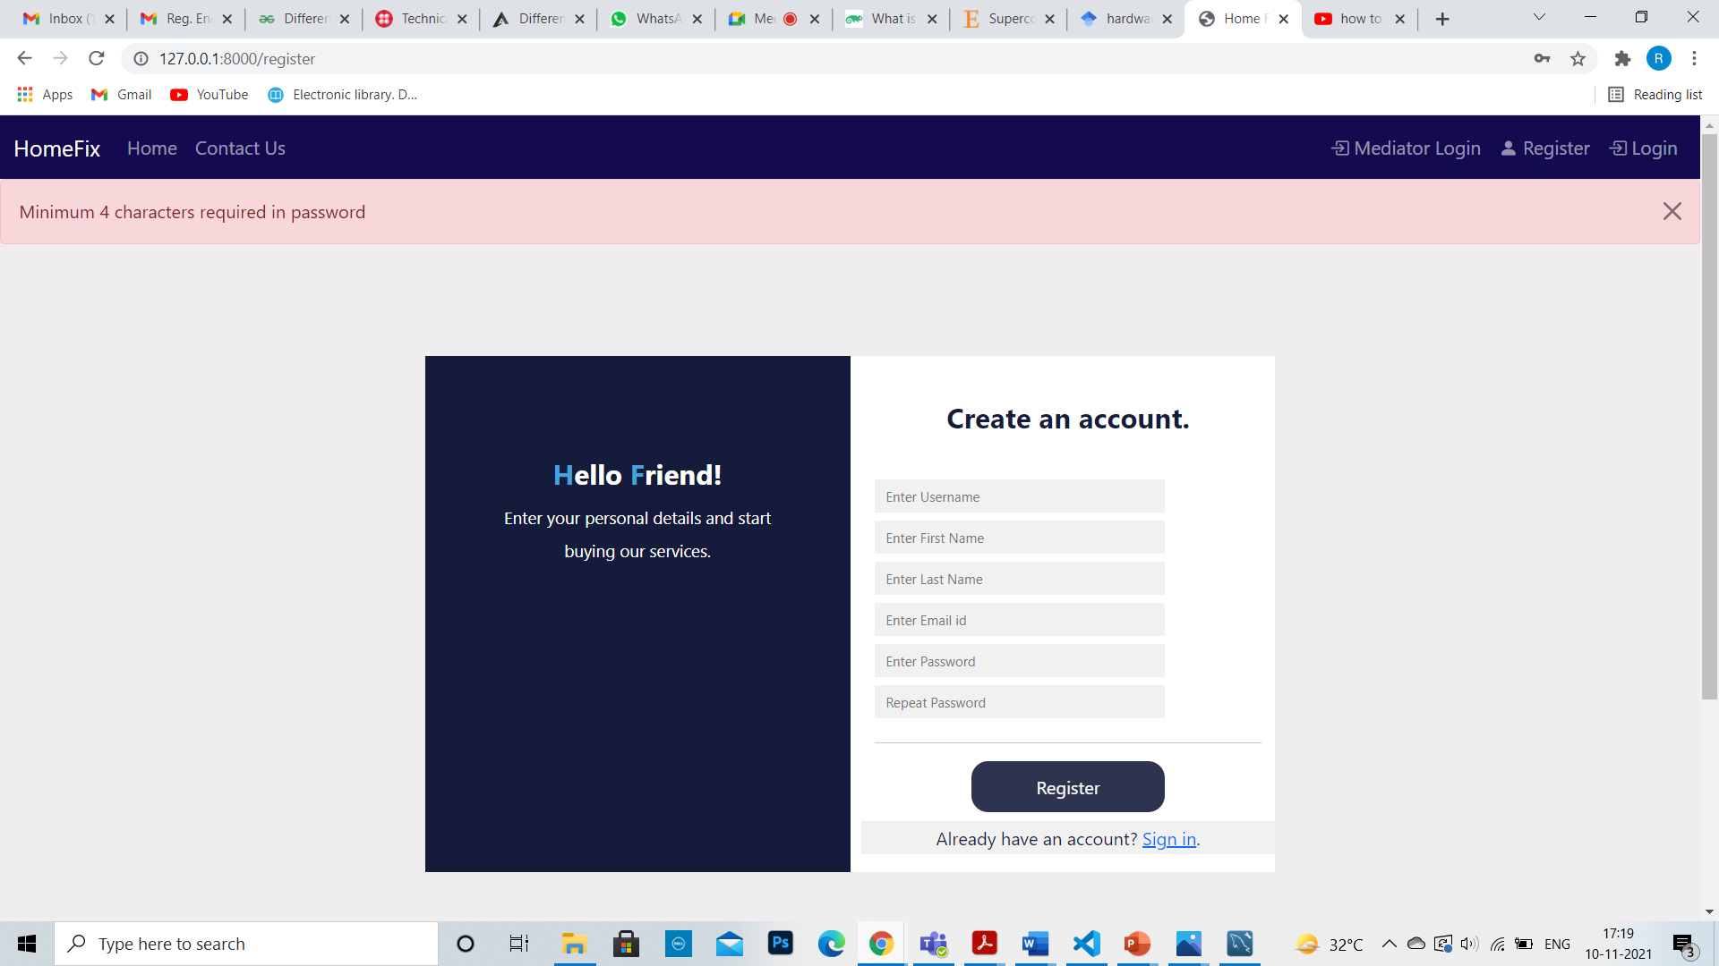


Messages
Error at time of login
Errors at time of register

Slide 19
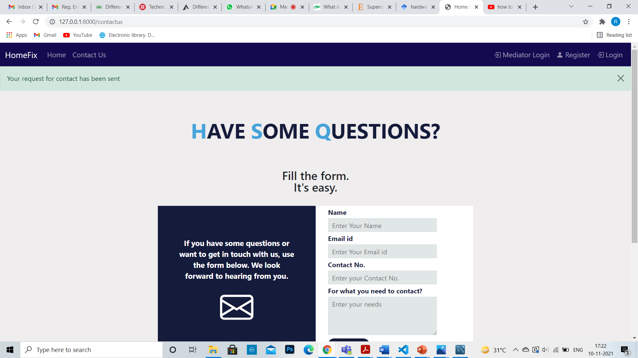
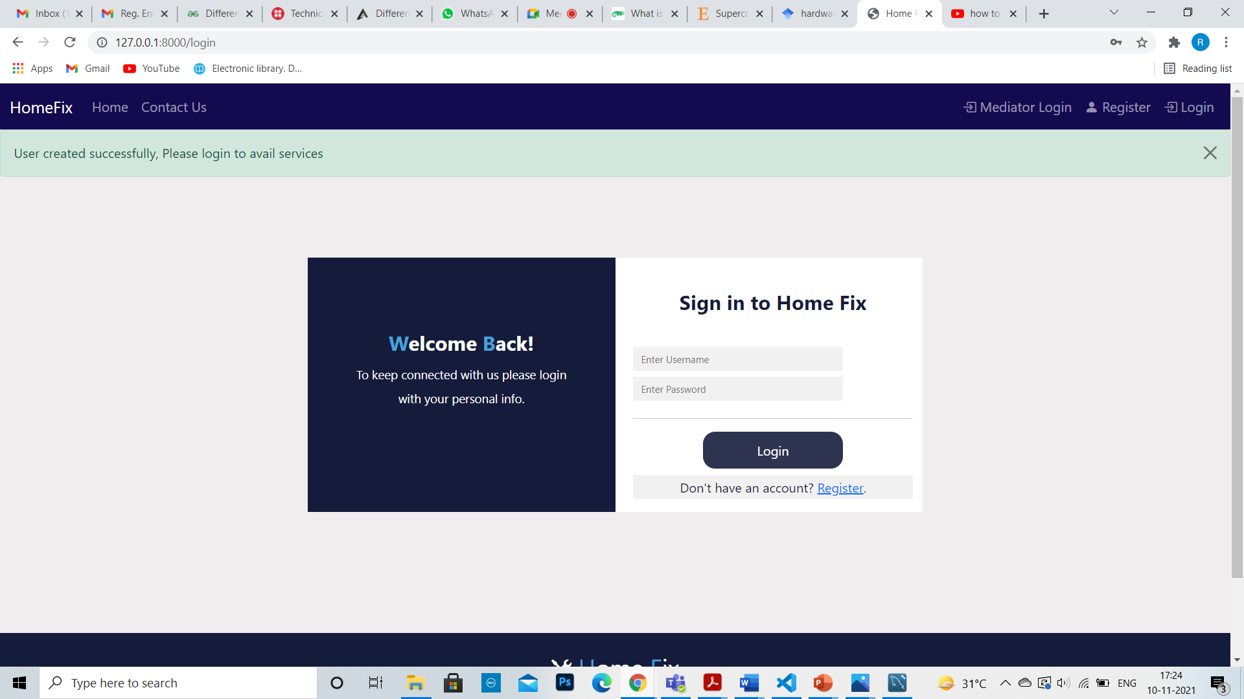
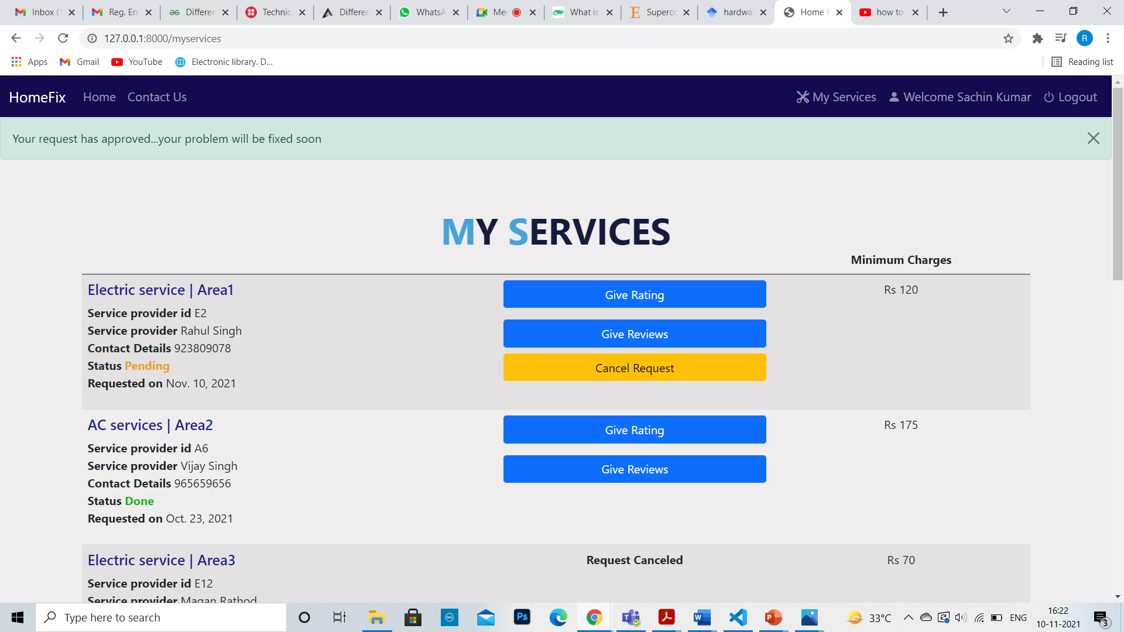
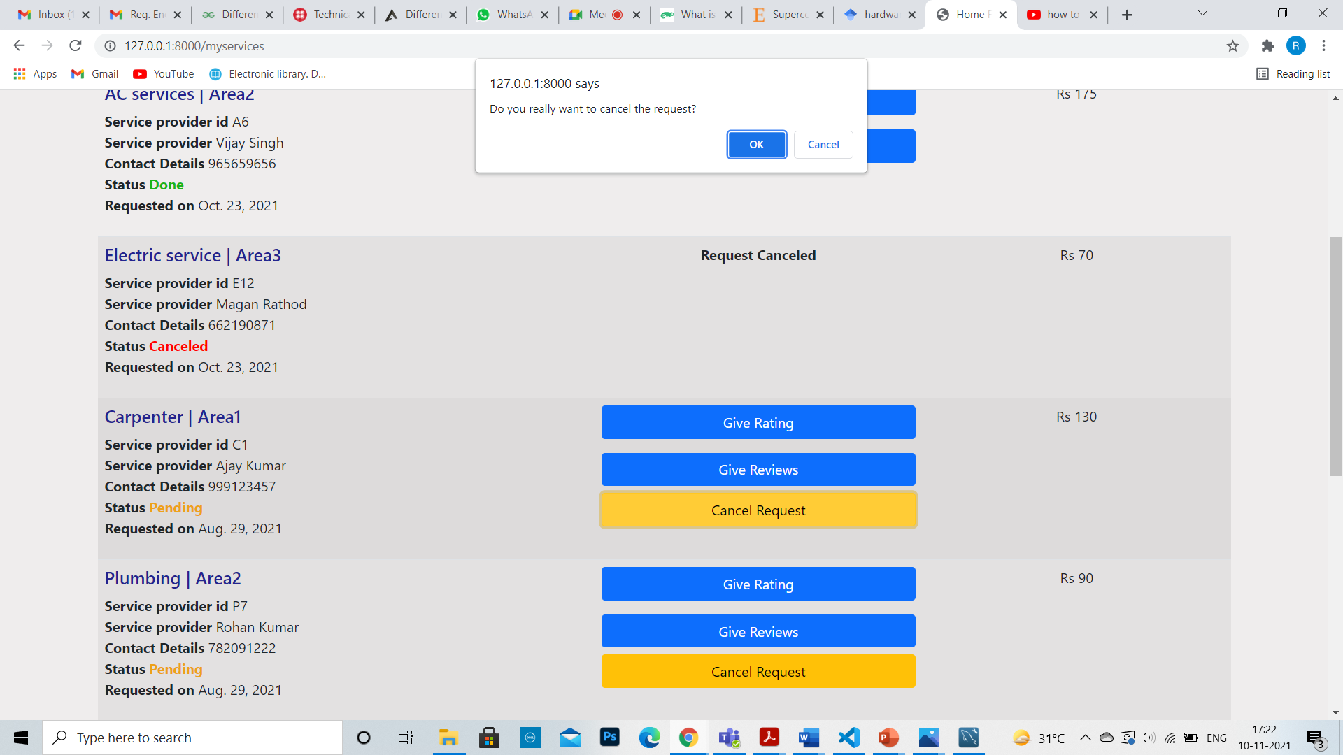
Success Messages
Confirmation Message

Slide 20


